Slide 1
Team 5 MS2:
Miracle Weight-Loss Drug
Team Members:
Kavyanjali 2203390
Koh Chun Ince 2200960
Caleb Lee Jia Le 2201250
Muhammad Muslinmin Bin Mohd Saleh 2201360
Reuben Low Yu Xiang 2200931
Stafford Ho Sheng Xian 2201218
Yugendren S/o Sooriya Moorthi 2201512

Slide 2
Contents
Project Overview
Exploratory Data Analysis Overview
Analysis Activities
Data Processing
Pipeline Architecture Overview
Model Training Overview
Random Forest as the Optimal Model
Model Results

Slide 3
Overall Pipeline Design Overview
Initiation:
Start the pipeline by running pipeline.sh in the PURE_SRC_CODE folder, which presents a menu for stage selection.
Data Cleaning (clean_data.exe):
Cleans raw data from OTH_DATA/training_data, handling missing values and encoding variables.
Outputs cleaned data to OTH_DATA/cleaned_data.
Exploratory Data Analysis (EDA) (perform_eda.exe):
Analyzes cleaned data to generate visual summaries and insights on data distribution, trends, and outliers.
Saves results in EDA_DATA.
Model Training (model_training.exe):
Trains machine learning models on data from OTH_DATA/training_data or OTH_DATA/cleaned_data.
Saves trained models to ML_DATA/model_outputs.
Prediction and Evaluation (perform_prediction.exe):
Generates predictions using trained models and stores results in ML_DATA/predict_outputs.
Saves evaluation visuals (e.g., ROC curves) to ML_DATA/visualize_output.
Execution Notes:
Configuration is handled by config.txt in the SCRIPTS_CFG folder.
To run, execute pipeline.sh from PURE_SRC_CODE.
Notes:
5. can pick all the models
1 model/multiple model/all models for both training and prediction To give more test results for research purposes
Train on proportion of data set to optimise model for lesser overfitting

Slide 4
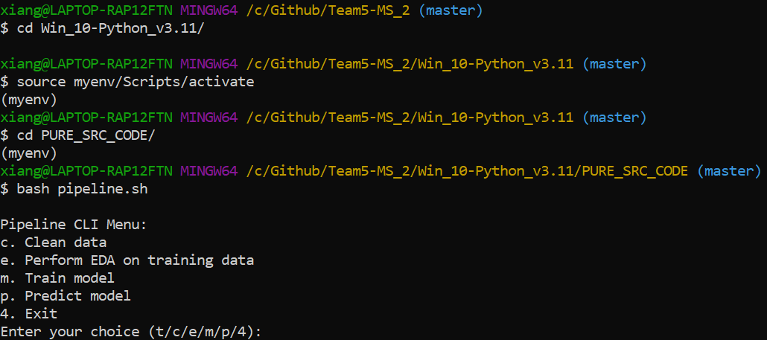
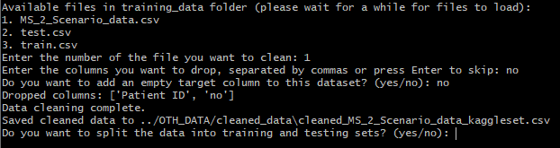
Pipeline (CLI interface)
Python 3.11, Windows 10
Options for cleaning, analysis, and training.
Access the CLI Menu:
Options: C (Clean Data), E (Perform EDA), M (Train Model), P (Predict), 4 (Exit).
Workflow:
Clean data, Train model and predict
Clean data, EDA for analysis
Dataset Selection: Data selection of csv file and splitting of training,testing and validation data sets.
Notes:
Empahsize options of having gui and cli
n the context of classification reports, support refers to the number of actual occurrences of each class in the datase

Slide 5
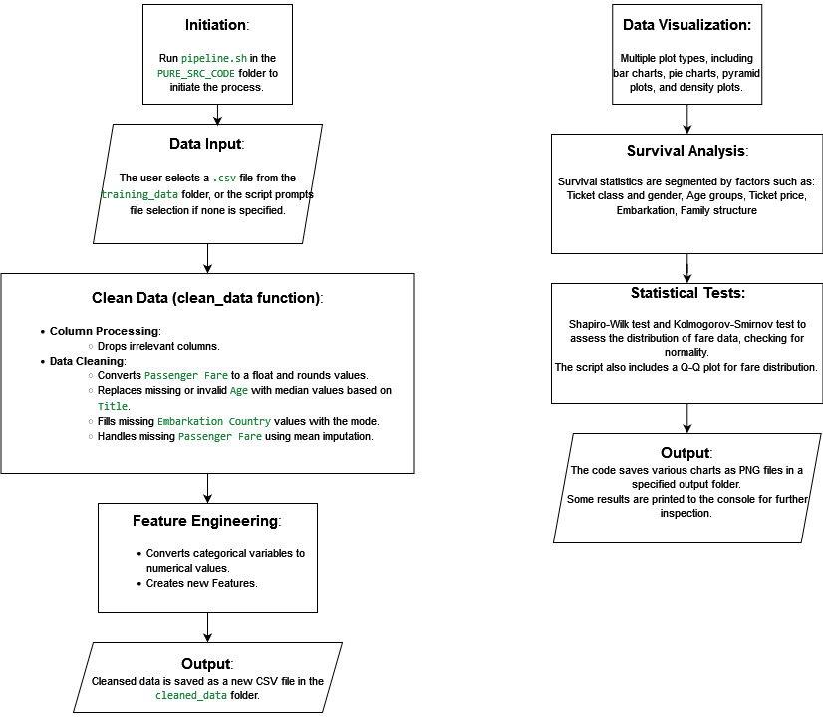
Pipeline Design - EDA
Figure 2: Perform EDA
Figure 1: Data Cleaning
Notes:
Perform eda is for visualization and analysis data Execution Flow:
pipeline.sh → clean_data.exe → Output: Cleaned Data (cleaned_data folder)
Initiation:
Run pipeline.sh (The script is designed to execute a series of commands in sequence, automating the setup and execution of the EDA or other parts of your project pipeline (such as data preprocessing, training models, or generating reports).) in the PURE_SRC_CODE folder to initiate the process.
Data Input:
The user selects a .csv file from the training_data folder, or the script prompts file selection if none is specified.
Clean Data (clean_data function):
Column Processing:
Extracts the title from the Name column and creates a new column for it.
Drops irrelevant columns (e.g., 'Passenger ID', 'Ticket Number').
Data Cleaning:
Converts Passenger Fare to a float and rounds values.
Replaces missing or invalid Age with median values based on Title.
Fills missing Embarkation Country values with the mode.
Handles missing Passenger Fare using mean imputation.
Feature Engineering:
Converts categorical variables like Gender and Embarkation Country to numerical values for modeling.
OneHotEncodes (is a technique used in data preprocessing to convert categorical data into a numerical format so that it can be used by machine learning algorithms. ) categorical columns (Ticket Class, Embarkation Country).
Creates age group categories based on age range.
Output:
Cleansed data is saved as a new CSV file in the cleaned_data folder.
Execution:
The script uses configuration files to manage input/output paths and ensures the pipeline runs sequentially.
Summary of Key Features:
Data Visualization:
Multiple plot types, including bar charts, pie charts, pyramid plots, and density plots.
Visualizes survival by age, gender, ticket price, embarkation point, and sibling/spouse/parent/child counts.
Age group analysis and ticket price quartiles are also considered in survival rate visualization.
Survival Analysis:
Survival statistics are segmented by factors such as:
Ticket class and gender: Analyzing the survival rate by gender across ticket classes.
Age groups: Plotting survival rates by age groups and creating age density plots.
Ticket price: Survival analysis based on ticket fare quartiles.
Embarkation: Survival rates by embarkation point, including analyzing the distribution by embarkation and plotting survival rates by ticket class and embarkation point.
Family structure: Survival rates are analyzed by the number of siblings/spouses and parents/children aboard.
Statistical Tests:
Shapiro-Wilk test and Kolmogorov-Smirnov test to assess the distribution of fare data, checking for normality.
The script also includes a Q-Q plot for fare distribution.
Output:
The code saves various charts as PNG files in a specified output folder.
Some results (like survival rates by class, gender, and ticket price) are printed to the console for further inspection.
Analysis Functions:
For each analysis category (e.g., survival by gender, age, ticket price), there is a corresponding function to:
Process the data (e.g., grouping by specific attributes).
Create plots for visualization.
Print relevant results for further interpretation.
Shapiro-Wilk Test and Kolmogorov-Smirnov Test:
These are statistical tests used to assess if a dataset follows a normal distribution.
The Shapiro-Wilk test is commonly used for small to moderately sized datasets, checking the null hypothesis that the data is normally distributed. A low p-value (typically less than 0.05) suggests the data significantly deviates from normality.
The Kolmogorov-Smirnov test (K-S test) compares the distribution of the sample data to a reference distribution (in this case, a normal distribution). It’s suitable for both small and large datasets.
Q-Q Plot (Quantile-Quantile Plot):
The script includes a Q-Q plot, which visually checks for normality by plotting the quantiles of the fare data against the quantiles of a normal distribution.
If the data is normally distributed, the points in a Q-Q plot will roughly lie on a straight line. Deviations from this line indicate departures from normality.

Slide 6
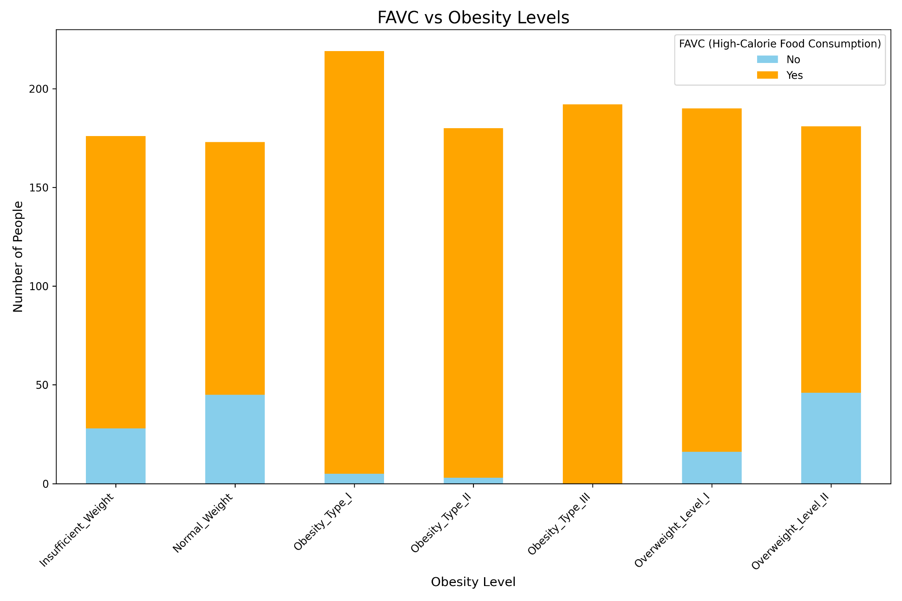
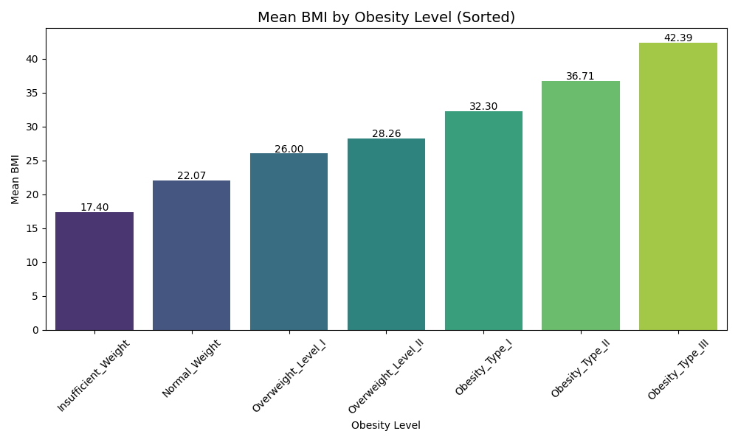
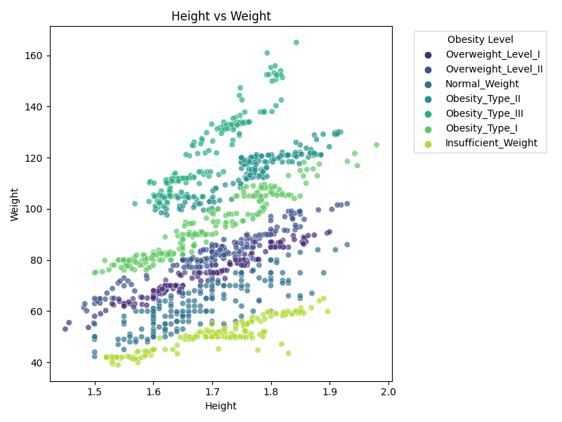
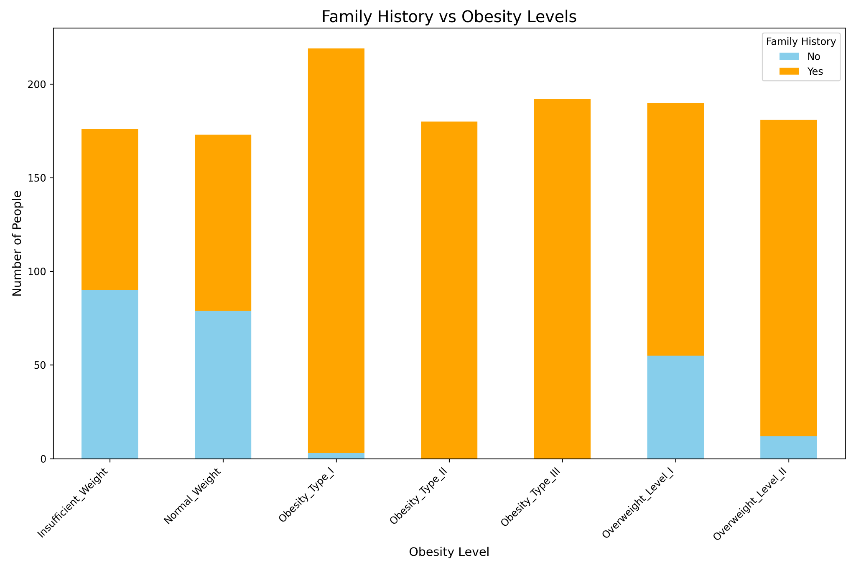
Key Findings from Exploratory Data Analysis (EDA)
Obesity Levels Correlation:
Height and Weight: Higher weight and certain height ranges are correlated with more severe obesity levels.
Family History: Positive family history of being overweight correlates with higher obesity levels.
Frequency of High-Calorie Food Consumption (FAVC): Frequent high-calorie food consumption is strongly associated with higher obesity levels, especially in severe obesity categories.
BMI and Obesity: BMI is strongly correlated with obesity levels, where higher BMI values are linked to more severe obesity categories.
Figure 3: High-Calorie Food Consumption
Figure 1: Height and Weight
Figure 2: Family History
Figure 4: BMI and Obesity
Notes:
Ticket Class: Higher survival rate for Higher ticket classes (First class).
Gender: Higher survival rate for Females than males, likely due to prioritization during evacuation.
Age: Higher survival rate for Younger passengers under 18, supporting the hypothesis that children were prioritized during rescue.
Family Presence: Higher survival rate for Passengers with one family member onboard, indicating that small family units offered support during evacuation.
Embarkation Point: Higher survival rate for Passengers who embarked from point "C", potentially due to a larger proportion of first-class passengers and women. Ticket Class: Higher ticket classes (First class) correlate strongly with survival. First-class passengers had a survival rate of ~62%, compared to 24.2% in third class.
Gender: Females have a much higher survival rate than males, likely due to prioritization during evacuation.
Age: Younger passengers, especially children under 18, show higher survival rates, supporting the hypothesis that children were prioritized during rescue.
Family Presence: Passengers with one family member onboard had a better survival rate (~50%) than those traveling alone, indicating that small family units offered support during evacuation.
Embarkation Point: Passengers who embarked from point "C" had higher survival rates, potentially due to a larger proportion of first-class passengers and women.

Slide 7
EDA Findings on Characteristics of High vs. Low Obesity Levels
High Obesity Levels (Obesity Types I, II, III):
BMI: Higher BMI values consistently correlate with these levels.
Physical Activity (FAF): Concentrated in the 0 to 2 range, indicating limited physical activity.
Calorie Awareness (SCC): A lower proportion of individuals monitor their calorie intake.
Dietary Patterns: Frequent high-calorie food consumption (FAVC) and additional eating habits (CAEC).
Family History: Strong association with a positive family history of being overweight.
Low Obesity Levels (Underweight, Normal Weight, Overweight Level I):
BMI: Lower BMI values, aligning with healthy or slightly overweight ranges.
Physical Activity (FAF): Wider spread, ranging from 0 to 3, reflecting varied activity levels.
Calorie Awareness (SCC): Higher proportion of individuals monitor their calorie intake, particularly in normal weight groups.
Dietary Patterns: Lower frequency of high-calorie food consumption and balanced meal patterns.
Family History: Lesser association with a family history of being overweight.
Notes:
Delving deeper into our findings on survivors versus non-survivors, we observed stark contrasts between these groups. Survivors tended to be first-class passengers, especially women and children. Small family units, with one or two family members onboard, had an increased likelihood of survival, possibly due to their ability to stay together and navigate evacuation procedures effectively. On the other hand, non-survivors were predominantly from third class, particularly males aged 19 to 35 who were traveling alone. This could reflect socio-economic barriers and the challenges single individuals might have faced in chaotic evacuation conditions. Furthermore, passengers who embarked from points S and Q, compared to point C, had a notably lower survival rate, which could imply socio-economic or physical layout factors at these embarkation points.

Slide 8
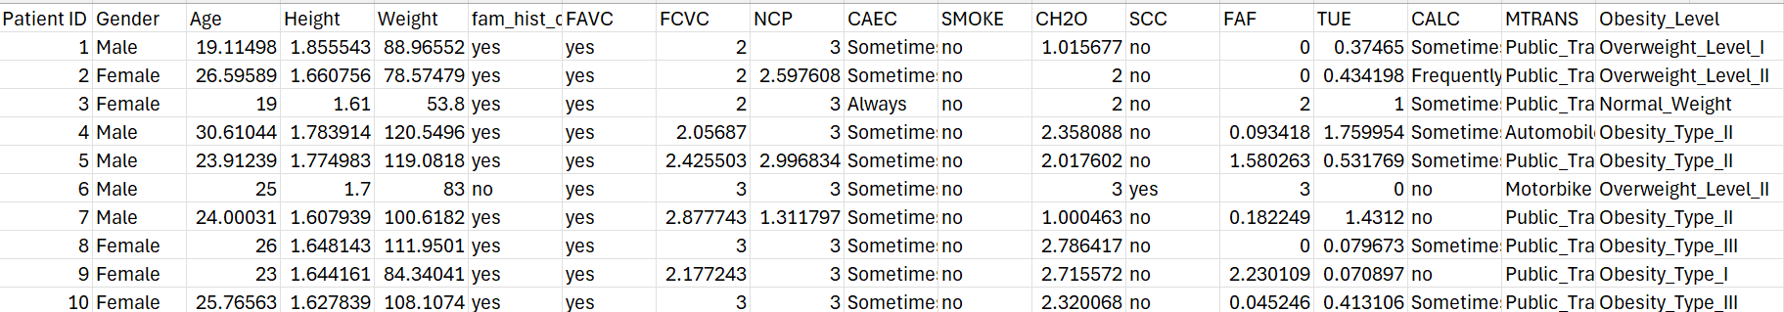
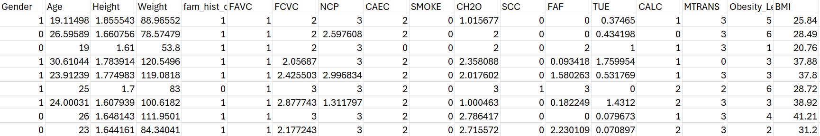
Exploratory Data Analysis (EDA): Analysis and Data Processing
Feature Selection (Removed):
Patient ID: Irrelevant for predictive modeling, removed to avoid overfitting.
Unnamed: 18: A blank column created by an extra delimiter, removed as it contained no useful information.
Handling Missing and Erroneous Data:
Numerical Columns (Age, BMI, Weight, etc.): Missing values imputed using the median to avoid dropping rows.
BMI: Calculated using the formula: BMI = Weight (Kg) / Height (m).
Age Grouping: Age was grouped into categorical bins (e.g., 0-18, 19-35) for better pattern recognition.
Data Transformation:
Age: Converted to Age Group (e.g., 0-18, 19-35) to capture age-related patterns more effectively.
BMI: Created a new feature for Body Mass Index, derived from Height and Weight.
Encoding Categorical Variables:
Gender, FAVC, CAEC, SMOKE, SCC, CALC, MTRAN, Obesity Level
Creating New Features:
Body Mass Index (BMI): BMI serves as a comprehensive measure that combines weight and height into a single metric, providing a stronger correlation
Body Fat Percentage: A valuable feature that offers a more accurate representation of obesity levels compared to using isolated attributes like gender, weight, or height.
Figure 5: Uncleaned Dataset
5.
Figure 6: Cleaned Dataset
Notes:
Handling Missing and Erroneous Data for Age: Why It’s Hard: Imputing missing "Age" values requires careful thought to avoid introducing bias or distorting the data. Age is also highly correlated with survival rates in some datasets, so accurate imputation is crucial for maintaining prediction quality.
Grouping by Title: Using titles like “Mr.”, “Miss.”, and “Mrs.” is a smart approach, as it provides a reasonable way to estimate age ranges. However, it requires extra steps: first, extracting the title from the "Name" column, then grouping and calculating medians. This is a multi-step process and requires special handling of edge cases like rare titles or missing titles. Age group: 1. Simplifying Complex Data for Patterns and Relationships
By grouping continuous ages into categories (e.g., 0-18, 19-35), you reduce the complexity of the data, making it easier to detect patterns or relationships between age and other factors. For instance, certain age groups (children, adults, seniors) might have distinct survival rates in a survival analysis.
Data cleaning
Feature Selection (Removed):
Name
Ticket Number
Passenger ID
Cabin Location
Handling Missing and Erroneous Data:
Age: The code uses median age values grouped by the Title column (e.g., “Mr”, “Miss”, “Mrs”).
Passenger Fare: Dollar signs removed, convert to numerical format.
Embarkation Country: Any ambiguous or missing codes in the (represented as "0" or empty values) were filled using the mode of the column.
Data Transformation:
Passenger Fare: Rounds the fare values to two decimal places, standardizing the format.
Age: Create new Age Group feature (e.g., 0-18, 19-35, etc.)
Encoding Categorical Variables:
Gender, Embarkation Country, Ticket Class: to numeric values (e.g, 0, 1, 2, etc.)
Creating New Features:
Name: A new feature, Title, was created by extracting titles (e.g., “Mr”, “Miss”, “Mrs”) from the Name.
Age: Create new Age Group feature (e.g., 0-18, 19-35, etc.) Exploratory Data Analysis (EDA) Overview
Analysis Activities:
Statistical Summary: Examine distributions of key variables.
Correlation Analysis: Explore relationships between demographic, social, and financial factors.
Multivariate Analysis: Analyze combined impact of multiple factors on survival likelihood. Data Processing:
Feature Selection: To focus on meaningful features enhances model efficiency.
Handling Missing and Erroneous Data: Improved data integrity and minimized noise for accurate model predictions.
Data Transformation and Scaling: Aligns data for algorithms that rely on normalized scales, enhancing performance.
Encoding Categorical Variables: Provides the model with numerical representations of categorical data, essential for effective prediction.
Feature Engineering: Enhanced feature set captures meaningful insights, enriching predictive model capabilities.
Exploratory Data Analysis (EDA): Analysis Activities
Statistical Summary:
Mean
Median
Minimum and Maximum
Standard Deviation
Correlation Analysis:
Passengers with Family Members
Gender
Ticket Class
Age
Passenger Fare
Embarkation Point
Number of Siblings or Spouses Onboard
Parents or Children Onboard
Multivariate Analysis:
Gender and Ticket Class
Embarkation Point and Ticket Class
Embarkation Point and Count of Women
Number of Siblings/Spouse and Child Status
Number of Siblings/Spouse and Gender
Number of Siblings/Spouse and Ticket Class
Number of Parent/Child and Ticket Class
Number of Parent/Child and Child Status
Number of Parent/Child and Gender

Slide 9
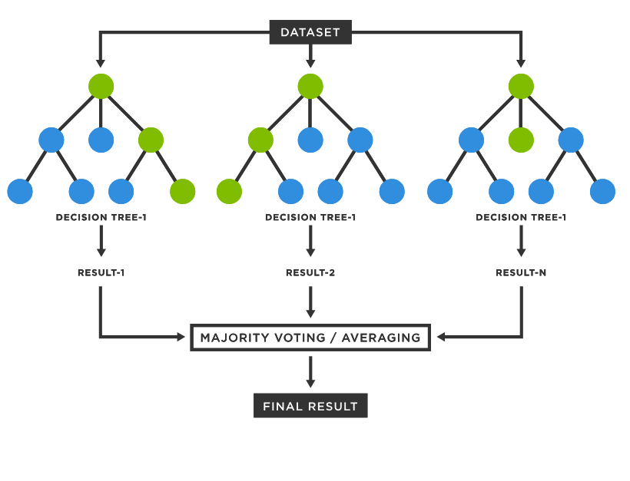
Machine Learning (ML): Random Forest as Optimal Model (D)
Optimal for Mixed Data Types: Handles both categorical and numerical features effectively, aligning with the dataset's diverse characteristics identified in EDA.
Robust Against Overfitting: Ensemble method reduces overfitting by averaging predictions across 300 trees, ensuring stability on unseen data (handles Variance).
Handles Class Imbalance: Voting mechanism across trees minimizes bias towards the majority class, supporting balanced performance across survival classes. (Aggregation)
Both Randomized Search Cross-Validation (CV) and Grid Search Cross-Validation (CV) were employed to fine-tune hyperparameters
Hyperparameter Choices:
n_estimators = 300: Provides prediction stability without excessive computation.
max_depth = 10: Controls complexity, capturing essential patterns without overfitting.
min_samples_split = 2 & min_samples_leaf = 1: Enables nuanced pattern capture while balancing detail and generalization.
Alignment with EDA Insights: Reflects the model’s ability to manage non-linear relationships and complex patterns within the data, crucial for predicting survival probabilities accurately.
Figure 8: Random Forest
Notes:
To optimize each model, both Randomized Search Cross-Validation (CV) and Grid Search Cross-Validation (CV) were employed to fine-tune hyperparameters, enhancing each model’s predictive power and ensuring an unbiased performance comparison. All models were trained and evaluated using the entire feature set, allowing them to capture complex interactions and patterns within the data.
`n_estimators`: Number of trees in the forest; increasing this can improve performance but also increase computation time.
`max_depth`: Controls the maximum depth of each tree; deeper trees can capture more complex patterns but may overfit.
min_samples_split: Increasing to 5 or 10 could help reduce overfitting.
min_samples_leaf: Setting to a higher value (e.g., 2 or 5) can prevent the model from learning too finely on noise.
Grid Search Cross-Validation exhaustively tries all combinations of the specified hyperparameters to identify the best combination. Time consuming.
Random search done first → In Randomized Search, the algorithm samples hyperparameters randomly, performing cross-validation for each sampled combination, and then scores each result based on the evaluation metric.
Decision tree alone high bias
Mean outcome of all tree will be calculated
Prevents overfitting and handles bias
Do random search narrow down value then do grid search around that value
Model Training Overview Goal: Identify the best model to predict survival outcomes in maritime accidents.
Models assessed:
Ensemble Method
Random Forest
Adaptive boosting
Gradient Boosting
XGBoost
K-Nearest Neighbors (KNN)
Support Vector Classifier (SVC)
Decision Tree
Logistic Regression
Naive Bayes (GaussianNB)
Neural Network (MLPClassifier)

Slide 10
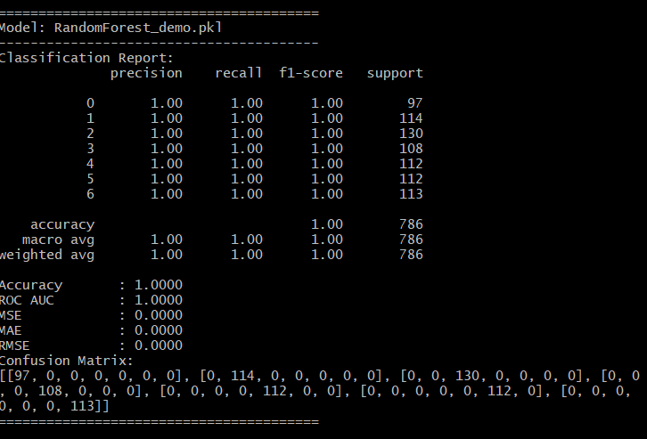
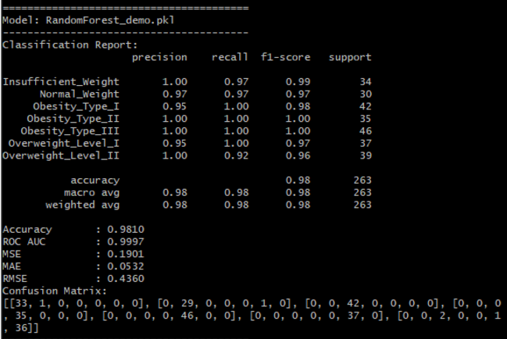
Machine Learning (ML): Random Forest Results ( Part 1)
F1 Score & Accuracy (An average across all categories):
Macro Average:
F1 Score (Testing): 0.98, Training: 1.00
Accuracy: Very high accuracy reflects a good performance of classification of obesity levels based on individual’s characteristics
Error Metrics:
MSE, MAE, RMSE: Low error values indicate accurate predictions on both training and testing sets, reflecting the model’s capability to minimize prediction errors effectively.
Overfitting & Underfitting:
Balanced Performance: Consistent F1 and accuracy scores across training and testing datasets show minimal overfitting, proving that the model generalizes well on unseen data.
Optimal Model Depth: Parameters like max_depth = 10 help in capturing patterns without making the model too complex.
Figure 1: Prediction on Training Data
Figure 2: Prediction on Testing Data
Notes:
Data set skewed towards non survivors
Priority shld be non survivors → company will NOT insure
Survivors might claim insurance otherwise
Accuracy measures the proportion of correct predictions (both positive and negative)
Mean squared error
Mean abs error
The square root of MSE, which converts the error back to the original units

Slide 11
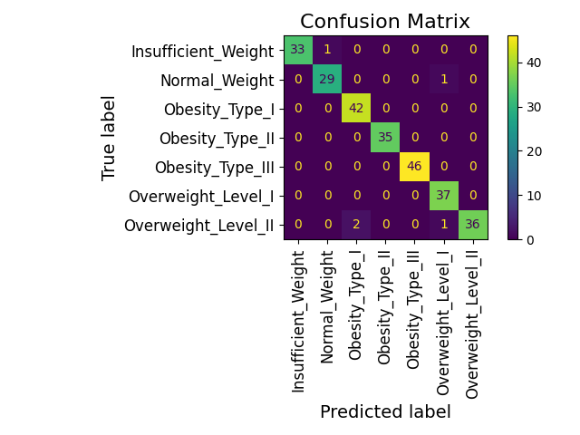
Confusion Matrix

Slide 12
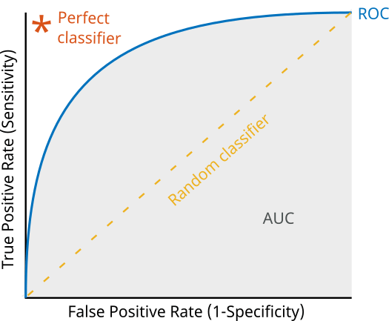
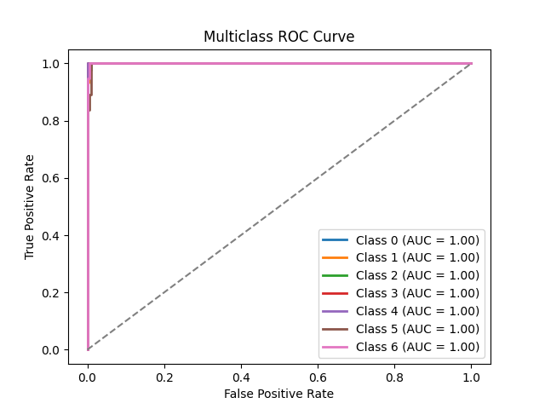
ROC(Receiver Operating Characteristic) Curve
ROC AUC score shows how well the classifier distinguishes positive and negative classes.
Notes:
Ideal case
True positive against false positive

Slide 13
Conclusion - Can you trust the model?
No, the client should not place 100% complete reliance on the model.
While the Random Forest model demonstrates exceptional performance with an accuracy of 0.98, a near-perfect ROC AUC score of 0.9999, and low error metrics (MSE = 0.19, MAE = 0.05, RMSE = 0.43), it is not without limitations.
Specifically, the model does not account for factors like:
Fitness context (e.g., athletes with high BMI due to muscle mass).
Temporary physiological changes (e.g., bulking phases).
Unmeasured variables such as metabolic health, detailed fitness logs, or psychological factors influencing obesity.
If not, what is the estimated percentage of trust the client should place on your model’s accuracy?
Approximately 90–95% trust is recommended.
This trust level reflects the model’s high accuracy, precision, recall, and F1 scores (all exceeding 0.95 across classes), as well as its ability to distinguish between obesity categories with near-perfect separability (ROC AUC = 0.9999).
However, the remaining 5–10% accounts for the model’s inability to handle outliers or unmeasured variables, which could lead to occasional misclassifications.
Reasons for 90–95% Trust Level:
Strong Performance Metrics: Accuracy of 0.98, ROC AUC of 0.9999, and F1 scores exceeding 0.95 demonstrate high reliability.
Minimal Misclassifications: Confusion matrix shows only 2 errors in closely related categories.
Effective Feature Use: Key features like BMI, body fat, and weight drive predictions, supported by additional lifestyle factors.
Limitations: Outliers (e.g., athletes, bodybuilders) and unmeasured variables (e.g., metabolic health) account for the remaining uncertainty.

Slide 14
END

